Slide 1
Taiji Managing Global User Traffic for Large-Scale Internet Services at the Edge
David Chou, Tianyin Xu, Kaushik Veeraraghavan, Andrew Newell, Sonia Margulis, Lin Xiao,
Pol Mauri Ruiz, Justin Meza, Kiryong Ha, Shruti Padmanabha, Kevin Cole, Dmitri Perelman
Notes:
Thanks for coming to my talk.
My name is David, and I’m a software engineer at Facebook.
Today, I’ll be talking about Taiji, our system for managing user traffic at the edge.

Slide 2

Facebook infrastructure is geo-distributed
Data Center
Notes:
Facebook operates a geo-distributed infrastructure, with dozens of datacenters around the world.
When operating our infrastructure, we care about efficiently utilizing our data centers and providing users with the best experience.
Routing user traffic has a big effect on both of these, and to show this, I’ll first explain how users are routed to datacenters.

Slide 3
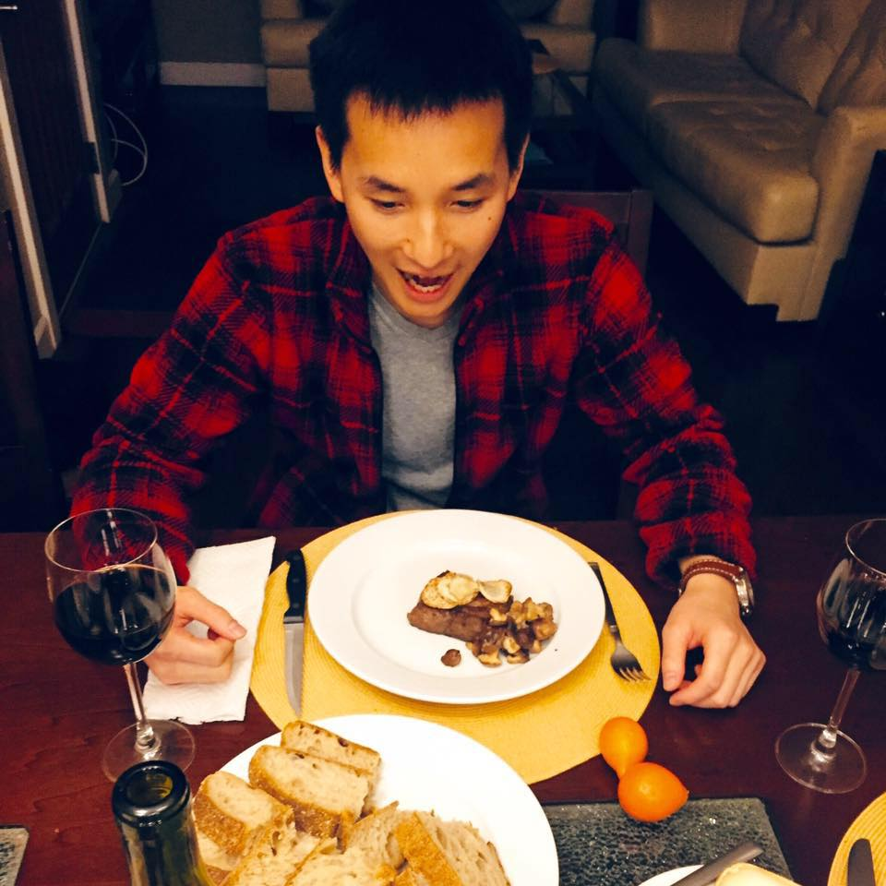

User requests are routed via edge nodes
Problem: how to route users from edge to datacenters?
Data Center
Edge Node
Notes:
When users access www.facebook.com from their device, they’re first routed to a nearby edge node, or a point of presence <animate>. Edge nodes are small datacenters Facebook places close to users for latency and caching benefits. For requests to static content, the request is served out of the edge by our CDN.
If the request is for dynamic content like newsfeed, the request must be routed to a datacenter <animate> for processing by a webserver. Depending on the request, the webserver may call several backend services for further processing. When done, a response is returned. <animate>
The reality is Facebook has lots <animate> of edge nodes routing to lots of datacenters. In this talk, I’ll be going over how we decide to route users from these edge nodes to our data centers.

Slide 4




Routing users for efficient utilization
Data Center
Edge Node
Notes:
There are three things we care about when routing user traffic.
The first is efficiently utilizing our datacenters. We don’t want to strand or overload our datacenter capacity. For example, let's say we route a bunch of users <animate> to the same datacenter <animate>. We might overload a datacenter by sending it too much traffic <animate>.

Slide 5
Routing users for a fast experience
Data Center
Edge Node
Notes:
Our second concern is routing users to nearby data centers to ensure we’re providing a good user experience.
For example, we could route users to faraway data centers <animate> and satisfy our first concern of efficiently utilizing our datacenters. But this would be a bad user experience. Instead, we'd like to route them to nearby datacenters <animate>.

Slide 6
Routing connected users for cache efficiency
Data Center
Edge Node
Notes:
Our last concern is to efficiently utilize our caches. Facebook infrastructure has several layers of caching and we want to ensure we’re effectively utilizing it.
We achieve this by consistently routing users to the same datacenter. This means subsequent requests can leverage previously cached data.
We took it another step further. We noticed our users are socially connected. For example, we have a group of users who are all friends <animate>. One friend makes a post <animate>. Both other friends will see the same post in their newsfeed. We realized if we route all three friends to the same datacenter <animate>, we can better leverage the cache <animate> since they’re fetching the same content.

Slide 7
Sites are growing, site is changing, failure is common
Data Center
Edge Node
Notes:
Accomplishing these three goals is challenging because our site is constantly changing. First, user demand is growing <animate>, and growth varies by geographical regions.
Second, our datacenters are constantly changing <animate>. They could upgrade, refresh, or decommission hardware, thus changing the capabilities of datacenters. We also build new data centers.
Lastly, failures are very common at our scale, from losing machines to losing a whole datacenter <animate>. When a datacenter goes offline, we need to reroute traffic to other up datacenters.

Slide 8
User demand is dynamic
Site traffic changes greatly based on geography and time of day
10x
RPS
0
0
Time
Notes:
So far, I’ve only shown our routing dynamics with simple examples. Here is a graph of user demand to better show the complexity.
This graph shows the requests per second to an edge node over a day. Notice at the peak, this edge node is serving over 3 million requests per second while at trough, it is around 300 thousand. That’s a <animate> 10x difference!
In addition, here is traffic <animate> at two more edge nodes, and we see peak demand occur at different times of day based on geography <animate>.
The reality of our infrastructure is we have lots of these edge nodes <animate> and their traffic <animate> changes greatly based on geography and time of day.

Slide 9
Statically mapping edge-to-datacenter traffic
50%
50%
Data Center
Edge Node
Notes:
For the first decade of Facebook’s existence, we survived with a static mapping of edge node traffic to datacenters.
For example, this <animate> edge node was fixed to send 50% of traffic to each nearby data center. This static mapping strategy started to breakdown in 2015, which I’ll show you next.

Slide 10
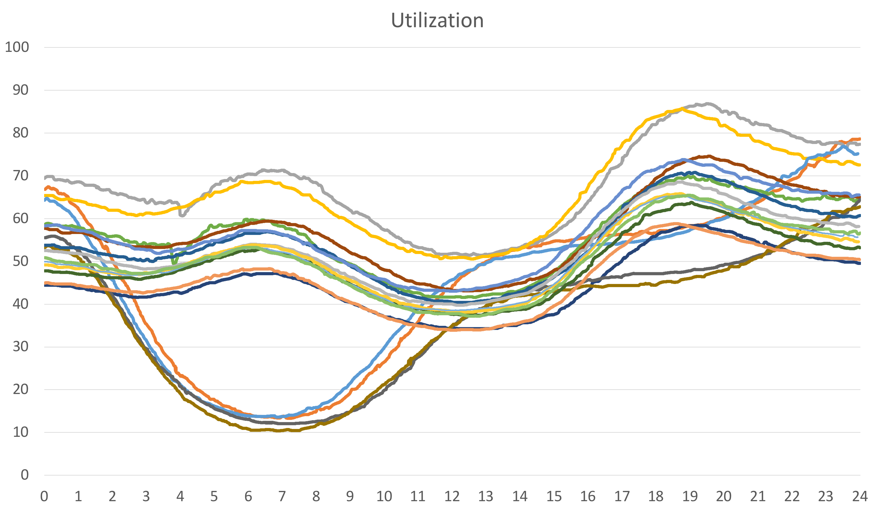
Static mapping is inefficient and dangerous
2015
Dangerous
Danger Zone
Utilization (%)
Static routing is
inefficient, error-prone,
and time-consuming
Inefficient
Time
Notes:
This is a graph of the utilization of our datacenters over a day in 2015. The x-axis is in hours and the y-axis is the datacenter utilization.
Notice at hour 6 <animate>, several datacenters are underutilized at 10% while the rest run at 60%. The datacenters could be better utilized by balancing traffic to them. We also have the concept of a danger zone <animate>, where we start to see our systems queueing and violating our SLA’s. At hour 19 <animate>, a couple datacenters are in the danger zone. The challenges of managing site traffic came to a head in the fall of 2015 when human operators had to tune the static mapping daily to ensure the site could run smoothly. We found that <animate> static traffic routing is inefficient, error prone, and time-consuming. We took our experience of manually managing user traffic and designed Taiji.

Slide 11
Taiji: User Traffic Management at the Edge
Continuous operation, reactive system
Balances datacenter utilization
Minimizes network latency
Leverages user connections for cache efficiency
Running in production for 4+ years
Notes:
Taiji is our system for managing edge to datacenter traffic. Taiji runs continuously, shifting traffic to react to site dynamics like user demand, capacity changes, and failures.
Taiji is able to balance utilization of our datacenters while minimizing network latency.
It also leverages user connections for cache efficiency, reducing reads to our backend storage by 17%.
Lastly, Taiji has been in production for over 4 years now.

Slide 12
Agenda
Taiji Overview
Traffic Allocation
User Routing
Evaluation
Notes:
For the rest of this talk, I’ll give an overview of Taiji, and specifically talk about how we decide the traffic allocation and user routing. Then, I’ll present our evaluation of Taiji.
~6 min mark

Slide 13

Taiji Objectives
Taiji
How much traffic to allocate from each edge to datacenter?
Balanced utilization
Minimize network latency
How to route users?
Cache efficiency
Traffic
Allocator
Traffic Allocation
Conn. Aware
Routing
User-to-Datacenter Mapping
Notes:
There are two fundamental questions. The first is how much traffic to allocate from each edge node to each datacenter. This has an impact on balancing utilization and minimizing network latency. The second is how to route the users. As discussed before, this has an impact on cache efficiency. We answer both of these questions with Taiji <animate>. I'll go into the details of each component, but first here's a high level overview of how these two components work.

Slide 14

Taiji Allocator decides traffic allocation
Users
Traffic
Allocator
Policy
Edge Nodes
Traffic Allocation
50%
50%
60%
40%
Conn. Aware
Routing
Data Centers
User-to-Datacenter Mapping
Notes:
The traffic allocator takes as input a routing policy configuration specifying whether to prefer utilization balance or network latency optimization.
The traffic allocator outputs a traffic allocation <animate>, which is a percentage breakdown of how much traffic each edge node should send to each datacenter.

Slide 15



Connection-aware routing maps users to datacenters
Users
Traffic
Allocator
Policy
Edge Nodes
Traffic Allocation
50%
50%
60%
40%
Conn. Aware
Routing
Data Centers
User-to-Datacenter Mapping
Notes:
Connection-aware routing takes this traffic allocation as input, and decides how to map users to datacenters.
Here we have connected users routed together to improve cache efficiency.
Connection-aware routing outputs a mapping of users-to-datacenters, which is distributed to our edge nodes <animate>, and this updates the routing accordingly <animate>. Now I’ll explain how we built each component, starting with the traffic allocator.

Slide 16
Part 1 of Taiji: Traffic Allocator
Goal: compute the traffic allocation accounting for utilization and network latency.
Users
Edge Nodes
Data Centers
Notes:
The traffic allocator's goal is to decide traffic allocation based on utilization and network latency. Let's go into the details of what this problem looks like.

Slide 17
Balancing utilization with latency-awareness
Target Avg Utilization = Total demand Total capacity
(4 + 4) / (6 + 4 + 6)
= 8 / 16
= 1 / 2
Users
Edge Node
Traffic (RPS)
Data Center
Capacity (RPS)
(higher network latency)
Notes:
In this example we want to balance utilization and be latency aware. The boxes represent edge node traffic and data center capacity. Each box is one request per second. The center datacenter is further from the edge nodes to represent higher network latency.
First, Taiji decides how much traffic to allocate to each datacenter to achieve balanced utilization. We compute the target average utilization <animate> by taking total demand and dividing it by total capacity. This shows each datacenter should be 50% utilized to achieve balance. <next slide>

Slide 18
Balancing utilization with latency-awareness
Target Avg Utilization = Total demand Total capacity
(4 + 4) / (6 + 4 + 6)
= 8 / 16
= 1 / 2
Routing policy trades off network latency vs balance
Users
Edge Node
Traffic (RPS)
3
1
3
1
Data Center
Capacity (RPS)
(higher network latency)
Notes:
Next Taiji decides how to allocate traffic to optimize network latency. The optimal routing here is to send as much traffic from each edge node to its closest datacenter, making sure to not exceed the target RPS. This results in each edge node <animate> sending 3 requests to their closest datacenters, and 1 request each to the faraway datacenter. This routing policy <animate> trades-off network latency for a balanced utilization. We designed Taiji to be customizable so service owners can configure how to trade off these two goals in a way that’s best for their service.

Slide 19



Services want different routing policies
Better
Network
Latency
More Balanced
DC Utilization
Notes:
We first implemented the traffic allocator only for our main web service. We built a closed-form solver to support the routing policy of balancing utilization while accounting for latency. Over time, Facebook’s products grew, and different services <animate> had different routing policy requirements. For example, a latency sensitive service wants a latency optimal routing policy while another service wanted a simple balancing policy.
We implemented each of these policies as separate closed-form solvers, but this quickly became hard to manage and time-consuming.
Debugging several different implementations in production is challenging, and there would be duplicated effort to fix issues.

Slide 20
Constraint solving for traffic allocation
Constraint solver to solve traffic allocation problem
Easily reconfigurable for service owners to experiment
Unify the different closed-form solvers
Notes:
We instead generalized the traffic allocation problem as a constraint satisfaction problem, and use a constraint solver to compute the optimal traffic allocation. This design enables service owners to experiment with different routing policies to find what works best for their service.
In addition, with this design, we unified our closed-form solvers, reducing the operational complexity of the traffic allocator.

Slide 21
Part 2 of Taiji: Connection-aware Routing
Goal: route connected users to the same datacenter
Traffic
Allocator
Policy
Traffic Allocation
Conn. Aware
Routing
User-to-Datacenter Mapping
Notes:
Next I’ll go over the second component of Taiji, connection-aware routing. The goal of connection-aware routing is to route connected users to the same datacenter while respecting the traffic allocation.
~10 min

Slide 22
Intuition: Route buckets of connected users
Users
User
Buckets
Initial approach: 21k fixed-size user buckets
Small buckets break up social groups
Notes:
Our initial approach was to group connected users into 21k fixed size buckets and route at the granularity of these buckets.
The downside is choosing a bucket size.
A small bucket size <animate> where every user is in their own bucket provides routing granularity, but breaks up social groups and loses out on cache efficiency.

Slide 23
Intuition: Route buckets of connected users
Users
User
Buckets
Initial approach: 21k fixed-size user buckets
Small buckets break up social groups
Large buckets sacrifice routing granularity
Notes:
A larger bucket size puts together more related users at the expense of routing granularity.

Slide 24
Connection-aware Routing
Goal: maximize routing connected users to the same datacenter
Approach:
Fine-grained buckets for routing accuracy
Route groups of related buckets for higher locality
Traffic
Allocator
Policy
Traffic Allocation
Conn. Aware
Routing
User-to-Datacenter Mapping
Notes:
Our approach is to create fine-grained buckets for routing accuracy, but also to route groups of related buckets to achieve higher cache locality.
So how do we know which buckets are related?

Slide 25
Hierarchical structure encodes bucket relationships
Key Characteristics:
Leaf nodes are buckets
Inner nodes represents subtree of user buckets
User buckets contain 0.01% of all users
All Users
Inner
Nodes
…
…
…
…
Buckets
Notes:
We do this by partitioning our users into a hierarchical structure to encode how buckets are related. We create the structure by first taking the set of all users, and we run a balanced partitioning algorithm to create <animate> two subgroups of equal size minimizes the connections between the subgroups. This is run recursively <animate>, creating a <animate> hierarchical structure. <animate> In this structure, the leaves are user buckets and the inner nodes represent all the buckets in the subtree. We run the balanced partitioning algorithm until the user buckets each contain about 0.01% of users to achieve fine granularity in routing.

Slide 26
How to assign user buckets?
Stable Segment Assignment
Assigns large subtrees of buckets and splits few for fine-grained routing
All Users
Inner
Nodes
…
…
…
…
Buckets
Notes:
With this grouping of users into a hierarchy of buckets, we need to solve the problem of how to assign the user buckets. We do this with stable segment assignment. The intuition behind stable segment assignment is to try to assign large subtrees of buckets together while splitting a few to enable fine-grained traffic routing. You can read the details of the algorithm in our paper.

Slide 27
Recap
Taiji
Problem: How to route users from edge to datacenters?
Traffic Allocator
Balances utilization
Minimizes network latency
Connection-aware Routing
Cache efficiency
Traffic
Allocator
Traffic Allocation
Conn. Aware
Routing
User-to-Datacenter Mapping
Notes:
To recap, Taiji solves the problem of how to route users from the edge to our datacenters.
It does this in two parts. The traffic allocator decides a traffic allocation while balancing the utilization and minimizing the network latency, while connection-aware routing optimizes for cache efficiency by routing connected users together. We evaluate Taiji on exactly these three areas. Specifically, we ask three questions <next slide>:
How well can Taiji balance utilization?
How optimal is the network latency?
And does connection-aware routing improve cache efficiency?
I’ll start by going over how well Taiji can balance utilization.

Slide 28
Evaluation
Taiji
Traffic Allocator
How well can Taiji balance utilization?
How optimal is network latency?
Connection-aware Routing
Does it improve cache efficiency?
Traffic
Allocator
Traffic Allocation
Conn. Aware
Routing
User-to-Datacenter Mapping
Notes:
How well can Taiji balance utilization?
How optimal is the network latency?
And does connection-aware routing improve cache efficiency?
I’ll start by going over how well Taiji can balance utilization.

Slide 29
Humans managing edge-to-datacenter routing
2015
Utilization (%)
Time
Notes:
Here’s the graph from the beginning of the presentation of the utilization of our datacenters in 2015.

Slide 30
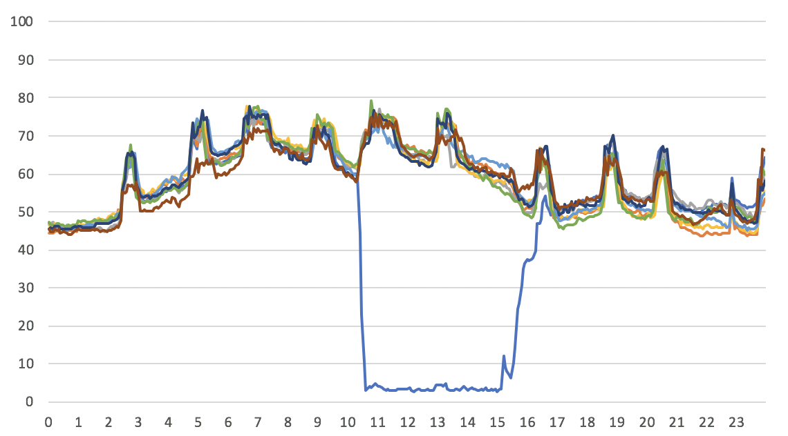
Taiji balances utilization effectively
2019
Balances within 3%, 80% of the time
Balances during dynamic events
Continuous deployment
Datacenter outages
Utilization (%)
Drain
Undrain
Time
Notes:
This is the same graph after Taiji has been deployed. Taiji is able to effectively load balance the utilization. For a stateless service, Taiji is able to balance the service’s utilization within 3%, 80% of the time. The divergence is due to continuous deployment, which are the spikes on this graph. Continuous deployment takes down machines to deploy new code, and this can cause imbalance. Even with continuous deployment, Taiji is able to keep the utilizations balanced. You can also see here a drain and undrain event was necessary to mitigate a site issue. Taiji is able to react to this event and balance the utilization.
~13

Slide 31
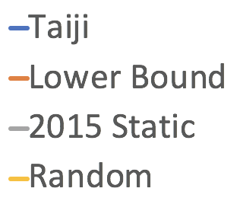
Taiji optimizes network latency
Network RTT (ms)
Lower bound is theoretical and assumes infinite capacity
Best of both worlds
Time
Notes:
For evaluating network latency, we want to see that Taiji is improving network latency. We compare the network latency of Taiji’s routing decisions with three scenarios:
The first is random routing
The second is the static mapping we had in 2015, which was hand tuned by a human for optimal latency
The third is a theoretical lower bound. The theoretical lower bound is simulated by routing the traffic from an edge node to its closest datacenter, assuming datacenters has infinite capacity. One thing to note is that this lower bound cannot be achieved by better routing and would require more capacity.
Taiji achieves a better network latency than the random and static mapping. Also, Taiji is able to stay within 30 ms of the lower bound throughout the day, which we find tolerable for this application. The key thing to note is that we are able to improve the network latency over the static mapping created by a human where the human attempted to optimize for latency. In addition, Taiji achieves this while balancing the utilization. Taiji is able to achieve the best of both worlds, improving the safety of the site and the network latency.

Slide 32
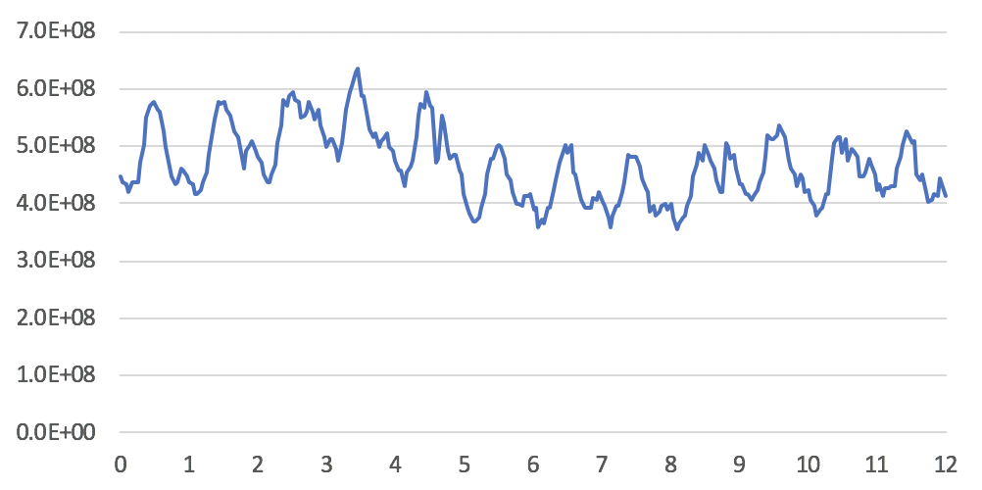
Taiji reduces demand on backend storage
DB Reads
(QPS)
Conn. Aware
Routing Rollout
Days
17% reduction in reads to backend storage
Notes:
Finally we evaluate connection-aware routing on its effectiveness in improving cache efficiency.
While I could show some graphs on cache improvement, we found it most meaningful to show data on the reduction of reads to our backend storage because this translates into reduction in backend capacity.
This figure shows the amount of queries per second to our backend storage over time. After the rollout of connection-aware routing, we observed a 17% reduction in queries to our backend storage.

Slide 33
Limitations
Taiji only considers edge-to-datacenter latency
Service owners specify routing policy to optimize end-to-end latency
Taiji only considers frontend utilization
Continuous loadtesting to ensure backend sized properly
Notes:
Before I conclude, let me go over 2 limitations of Taiji.
The first is that Taiji only considers the edge-to-datacenter latency. However, service owners care about end-to-end latency. These can be at odds with each other when, for example, a latency optimal routing policy may run a datacenter at higher utilizations, and cause higher processing times due to queueing and increase end-to-end latency. In this case, balancing the utilization will achieve a better end-to-end latency. We rely on service owners to configure Taiji to account for this.
The second is that Taiji only considers the frontend utilization, and doesn’t consider backend utilization. We solve this problem by running continuous loadtests to verify backend services are sized properly.

Slide 34
Conclusion
Running in production for 4+ years, reacts to daily site dynamics
Flexible configuration to trade off balanced utilization with network latency optimization
Routing connected users reduced reads on backend storage by 17%
Notes:
To conclude, I present our system Taiji, that has been running in production for over four years and reacts to daily site dynamics.
Taiji supports flexible configuration so that services can make their own decisions about trading off a balanced utilization with minimizing network latency.
And finally, Taiji routes connected users, which reduces the reads to our backend storage by 17%.
Thanks for listening to my talk, and now I’ll be taking questions.

